Slide 1
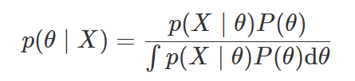
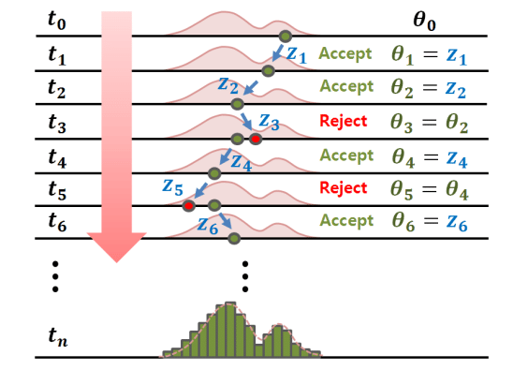


Monte Carlo Methods
Bayes Theorem:
Markov Chain Monte Carlo (MCMC) provides a general
Sampling framework
Approximate Inference
Laplace
Monte Carlo
Variational Inference
Monte Carlo Integration:

Slide 2
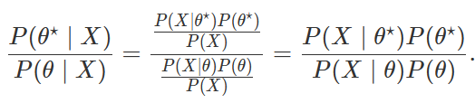

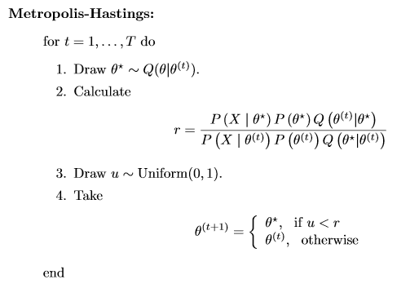
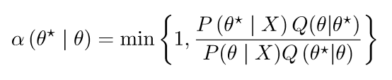
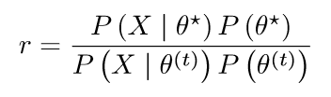
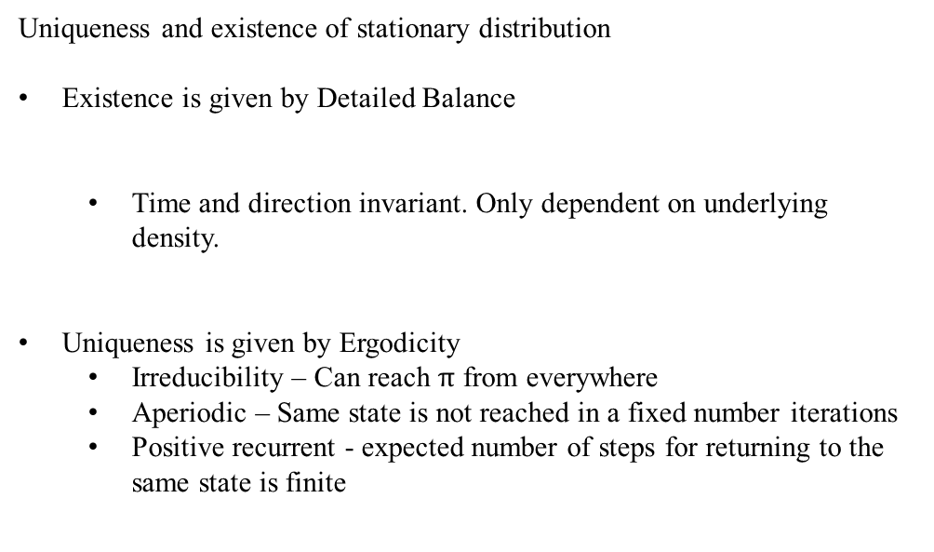
Markov Chain for MCMC
Uniqueness and existence of stationary distribution
Existence is given by Detailed Balance
Time and direction invariant. Only dependent on underlying density.
Uniqueness is given by Ergodicity
Irreducibility – Can reach $π$ from everywhere
Aperiodic – Same state is not reached in a fixed number iterations
Positive recurrent - expected number of steps for returning to the same state is finite
.
Such framework is provided by the Metropolis–Hastings algorithm
If Q is symmetric:

Slide 3
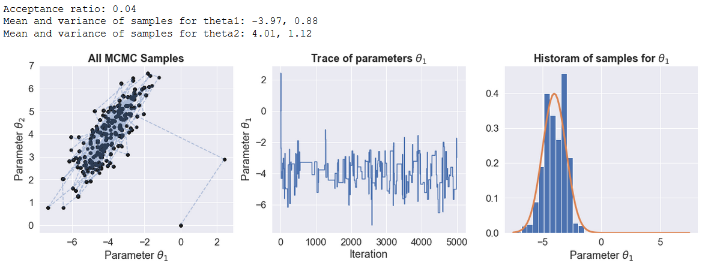
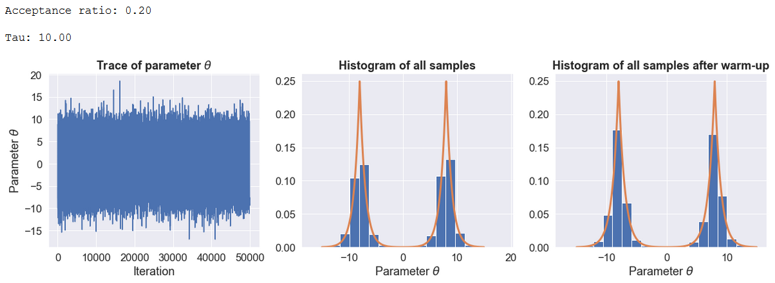
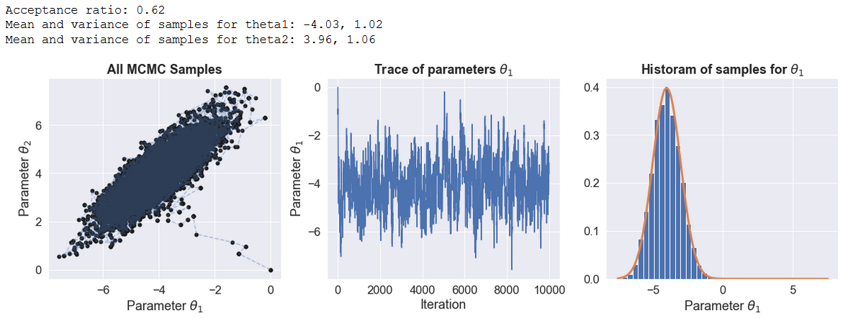
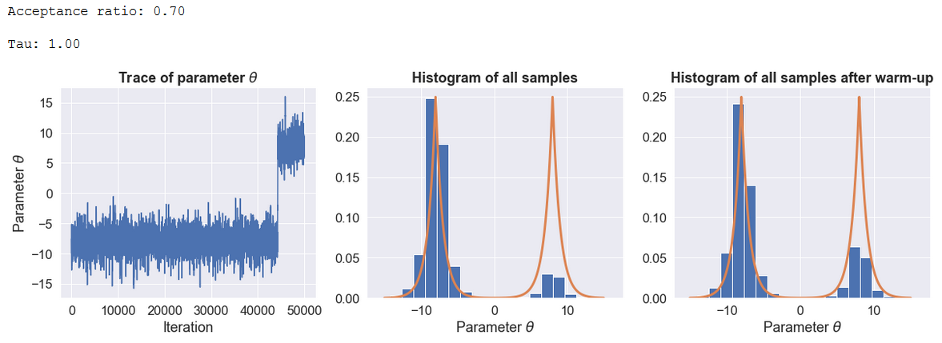
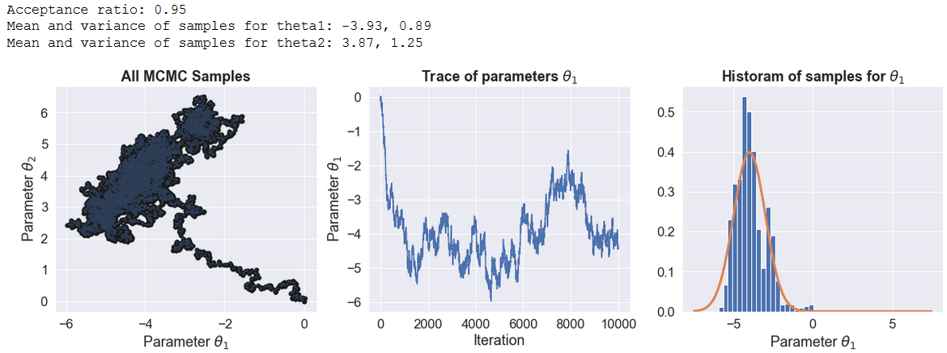
Metropolis Hastings
Warm up
Variation
Correlation and multimodal

